Slide 1

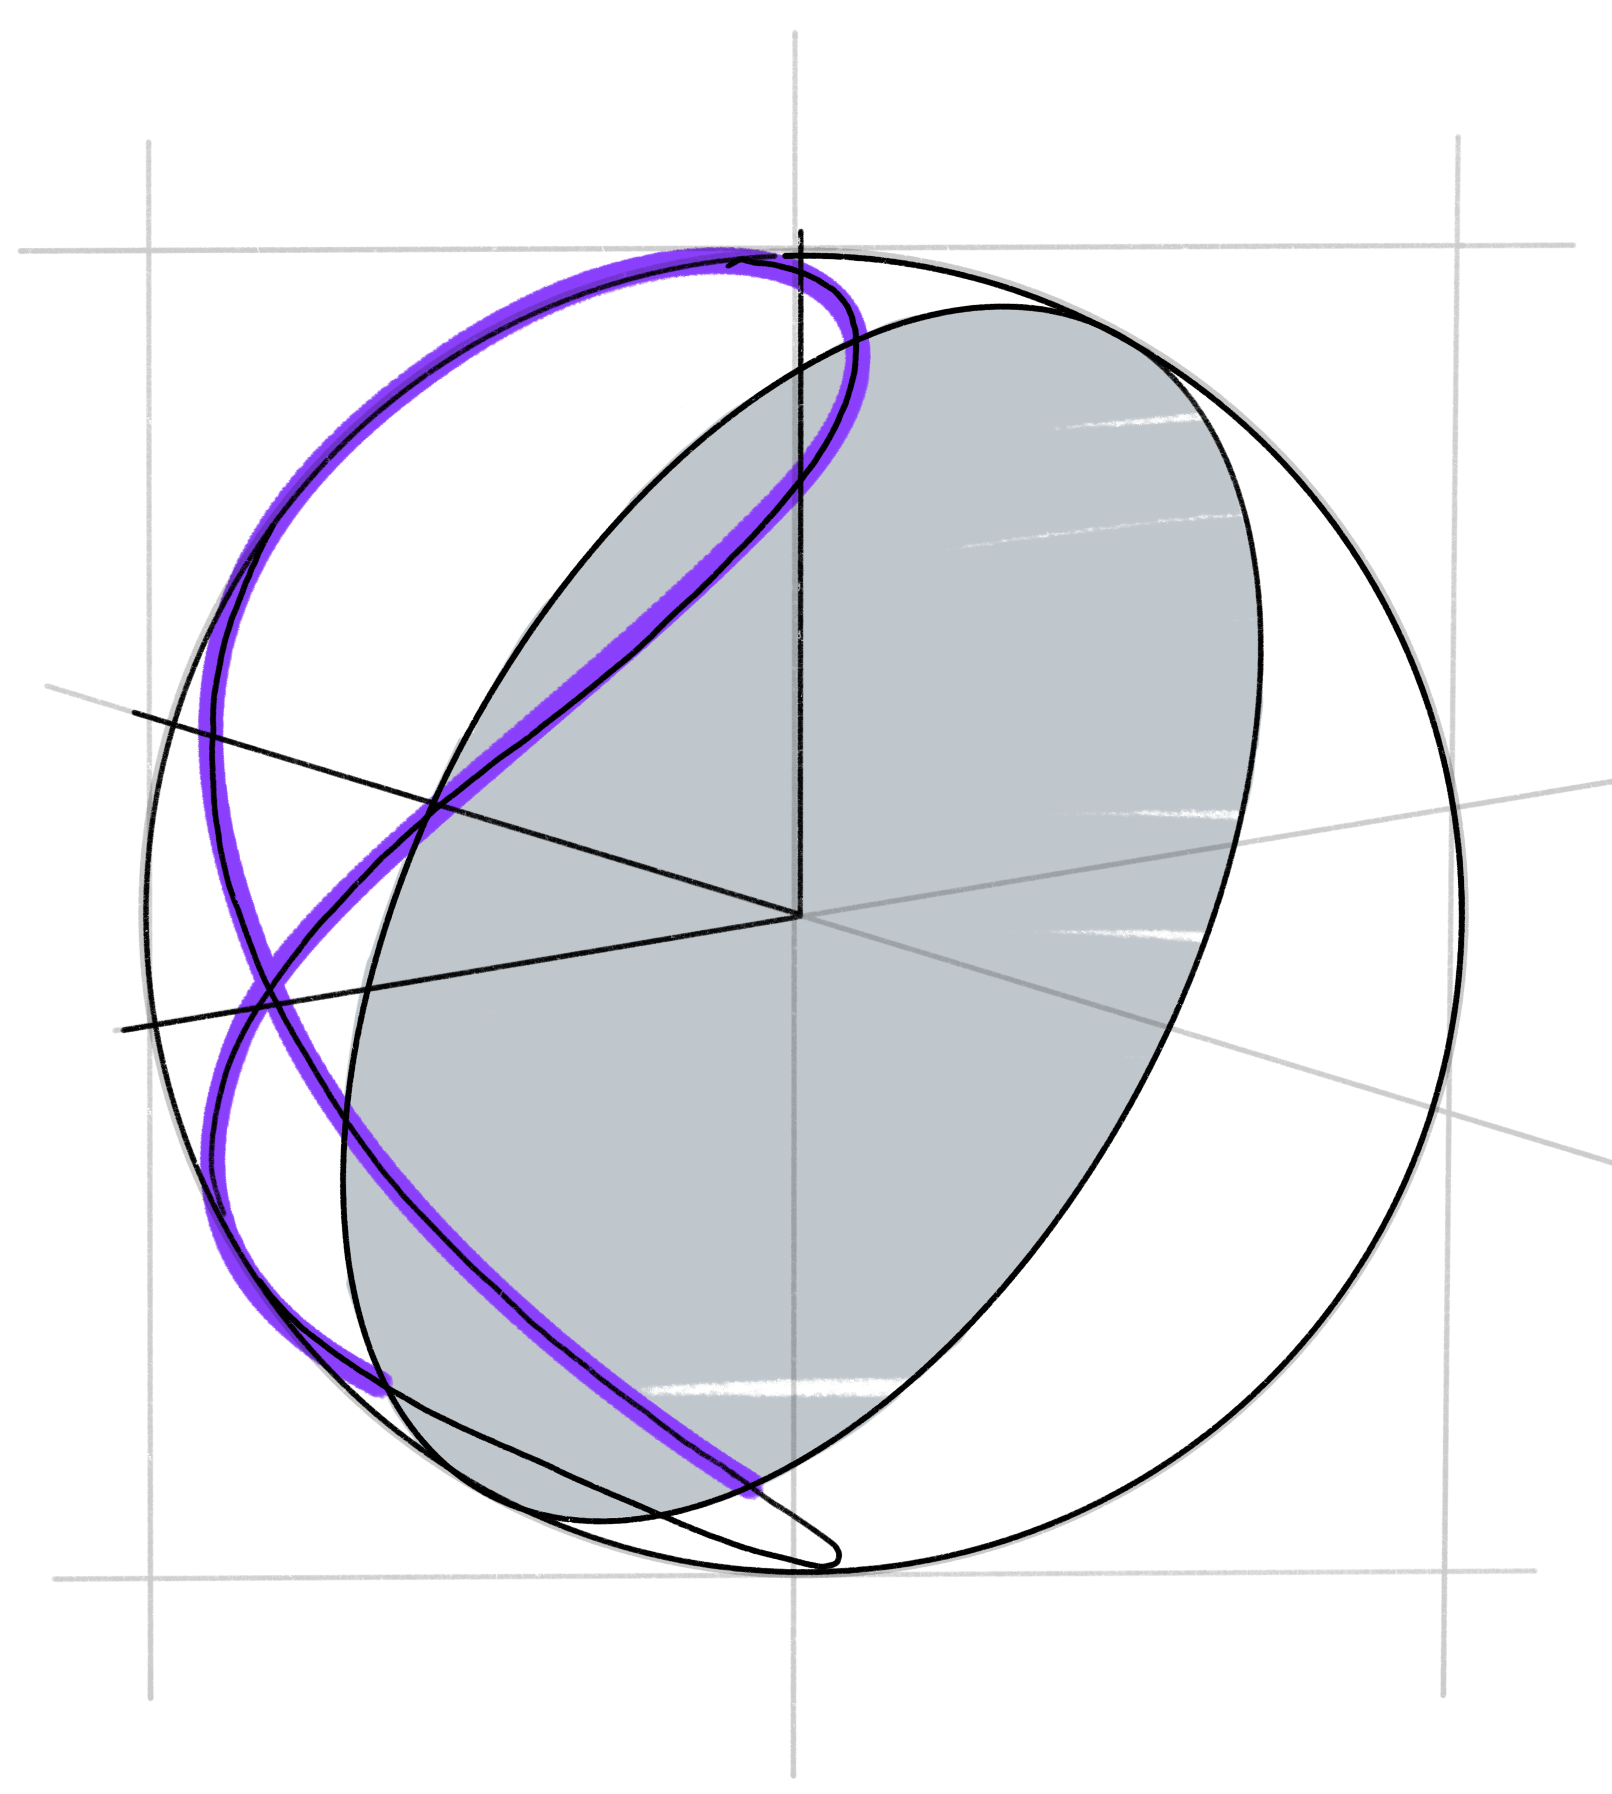
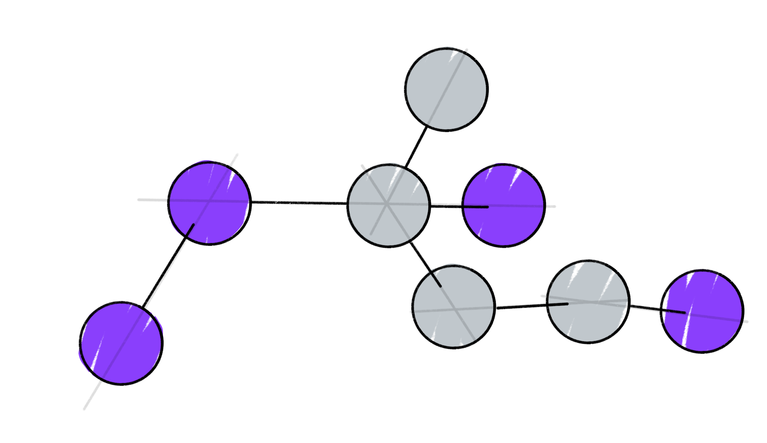
Predicting ground state with novel quantum descriptor of molecules using QML
#21
Members : Youngoh Son, Jaehoon Hahm, Daesung Kim, Seungwon Jung, Byeongsun Go, Seongwook Shin
Mentors : Gyeonghun Kim, Utkarsh Azad

Slide 2
Goal
Let’s Predict Ground State Energy of Molecules with QML!
Not VQE

Slide 3
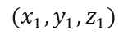
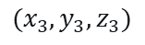
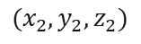
Introduction
What we have ….
Cartesian coordinates of atoms
$$(x_{2},y_{2},z_{2})$$
$$(x_{3},y_{3},z_{3})$$
$$(x_{1},y_{1},z_{1})$$
Can we predict ground state energy with only this information?

Slide 4
Introduction
YES
With Classical NN, algorithms such as ACSF, SOAP….

Slide 5
Introduction
We go quantum

Slide 6
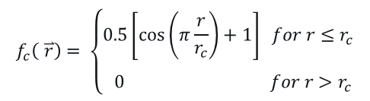
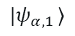
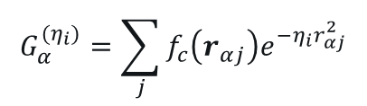
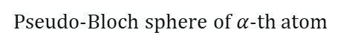
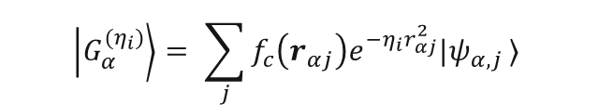
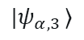
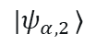
Introduction
Classical descriptor
$$G_{α}^{(η_{i})}=\sum_{j}{f_{c}\left(r_{αj}\right)e^{−η_{i}r_{αj}^{2}}}$$
$$f_{c}\left( \overset{⃑}{r_{ }}\right)= \left\{\begin{aligned}0.5\left[\cos\left(π\frac{r}{r_{c}}\right)+1\right] for r≤r_{c} \\ \\ 0 for r>r_{c}\end{aligned}\right.$$
$$|ψ_{α,1 }⟩$$
~ (atom index)
$$|ψ_{α,2 }⟩$$
Quantum descriptor (state vector) (Ours!)
$$\left|G_{α}^{(η_{i})}\right\rangle = \sum_{j}{f_{c}\left(r_{αj}\right)e^{−η_{i}r_{αj}^{2}}|ψ_{α,j }⟩}$$
.
.
.
$$|ψ_{α,3 }⟩$$
.
.
.
Pseudo-Bloch sphere of $α$-th atom

Slide 7
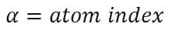
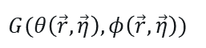
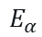
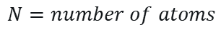
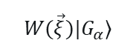
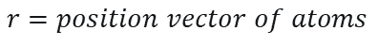


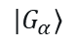
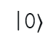
Methods
$$α=atom index$$
$$N=number of atoms$$
$$r=position vector of atoms$$
$$|G_{α}⟩$$
$$W(\vec{ξ})|G_{α}⟩$$
$$E_{α}$$
|0$⟩$
$$W(\vec{ξ})$$
|0$⟩$
$$M$$
$$G(θ\left(\vec{r}, \vec{η}\right),φ\left(\vec{r}, \vec{η}\right))$$
|0$⟩$

Slide 8
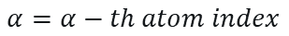
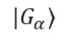
Methods
$$α=α−th atom index$$
$$|G_{α}⟩$$
$$W(\vec{ξ})|G_{α}⟩$$
$$E_{α}$$
|0$⟩$
$$W(\vec{ξ})$$
|0$⟩$
$$M$$
$$G(θ\left(\vec{r}, \vec{η}\right),φ\left(\vec{r}, \vec{η}\right))$$
|0$⟩$

Slide 9
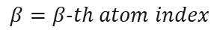
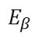
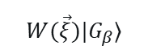
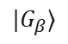
Methods
$$β=β−th atom index$$
$$|G_{β}⟩$$
$$W(\vec{ξ})|G_{β}⟩$$
$$E_{β}$$
|0$⟩$
$$W(\vec{ξ})$$
|0$⟩$
$$M$$
$$G(θ\left(\vec{r}, \vec{η}\right),φ\left(\vec{r}, \vec{η}\right))$$
|0$⟩$

Slide 10
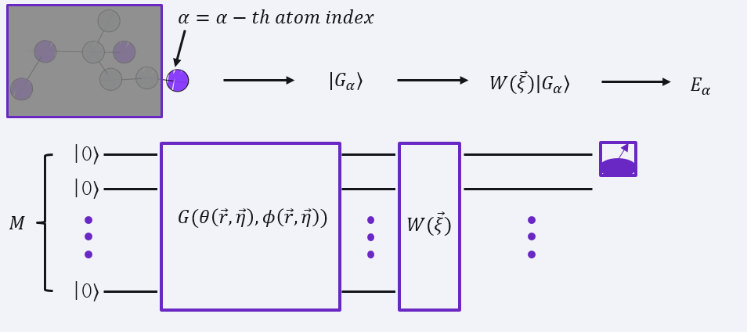
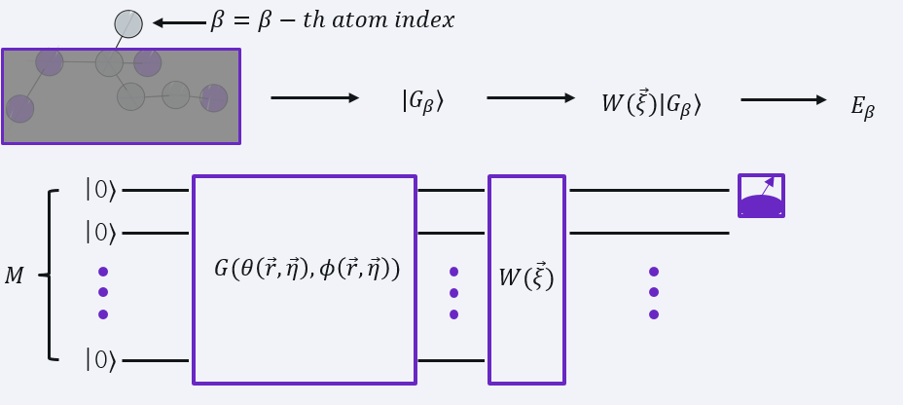

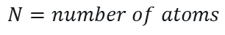
Methods
$$N=number of atoms$$
$$Σ_{α}^{N}E_{α_{ }}=E^{(predicted)}$$

Slide 11
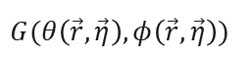
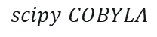
Methods
$$W(\vec{ξ})$$
$$G(θ\left(\vec{r}, \vec{η}\right),φ\left(\vec{r}, \vec{η}\right))$$
Cost function
$$C={\left(E^{\left(pred\right)}(\vec{η}, \vec{ξ})−E^{\left(DFT\right)}\right)}^{2}$$
$$scipy COBYLA$$

Slide 12
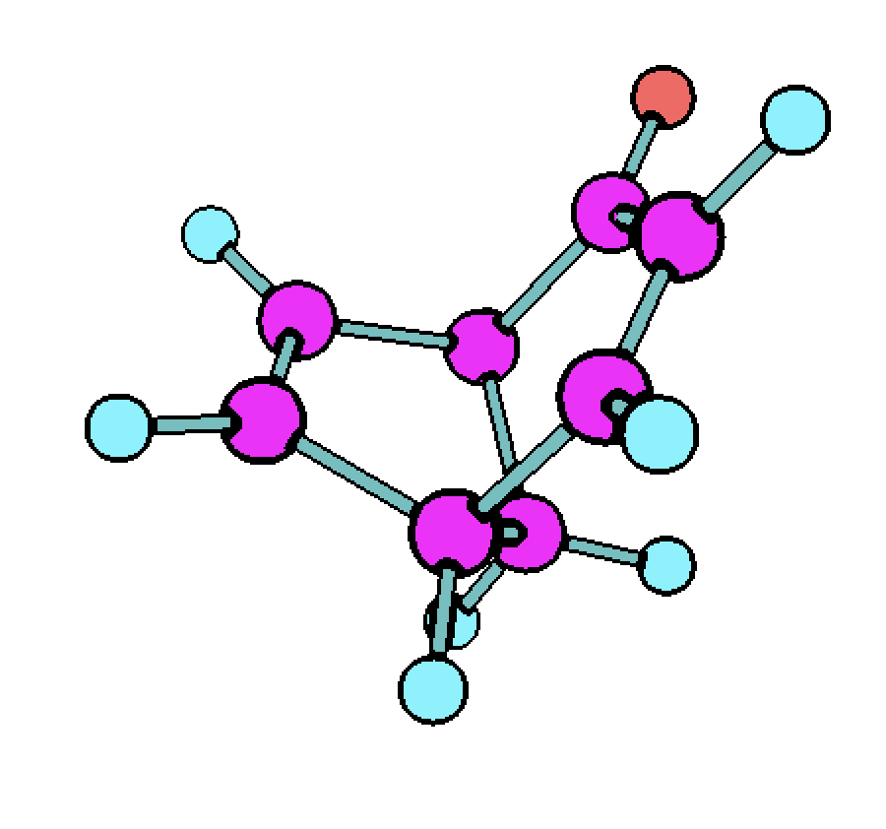
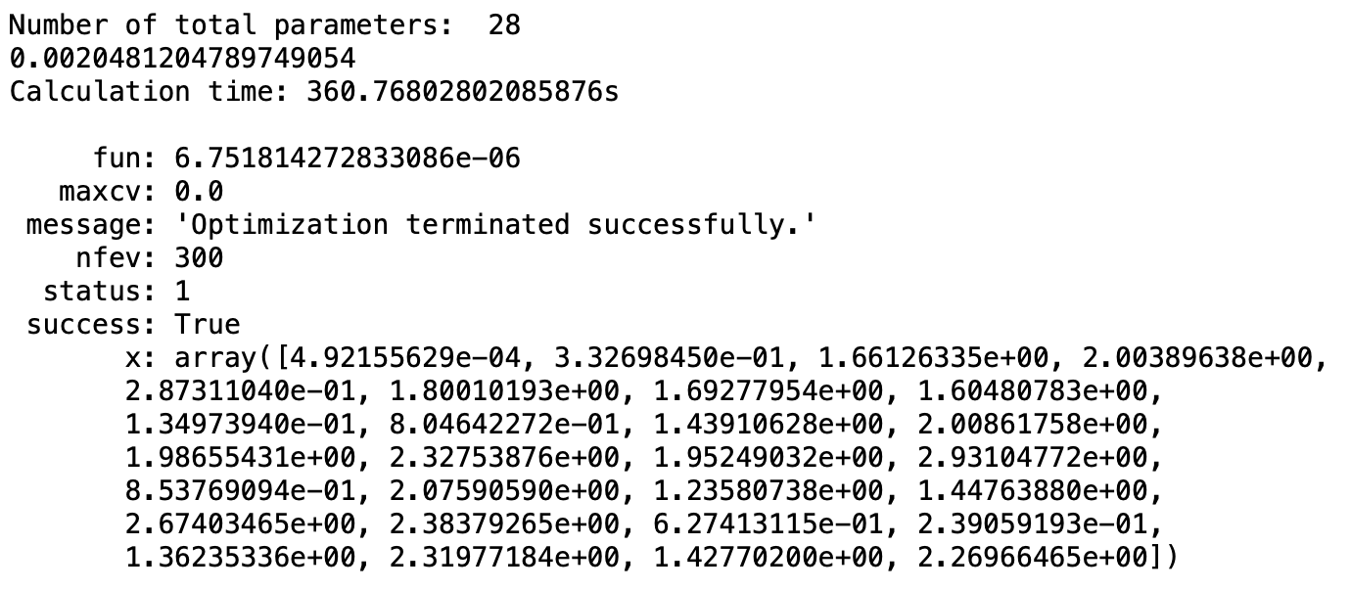
Results & Discussion
Succeeded for 1 molecule!

Slide 13
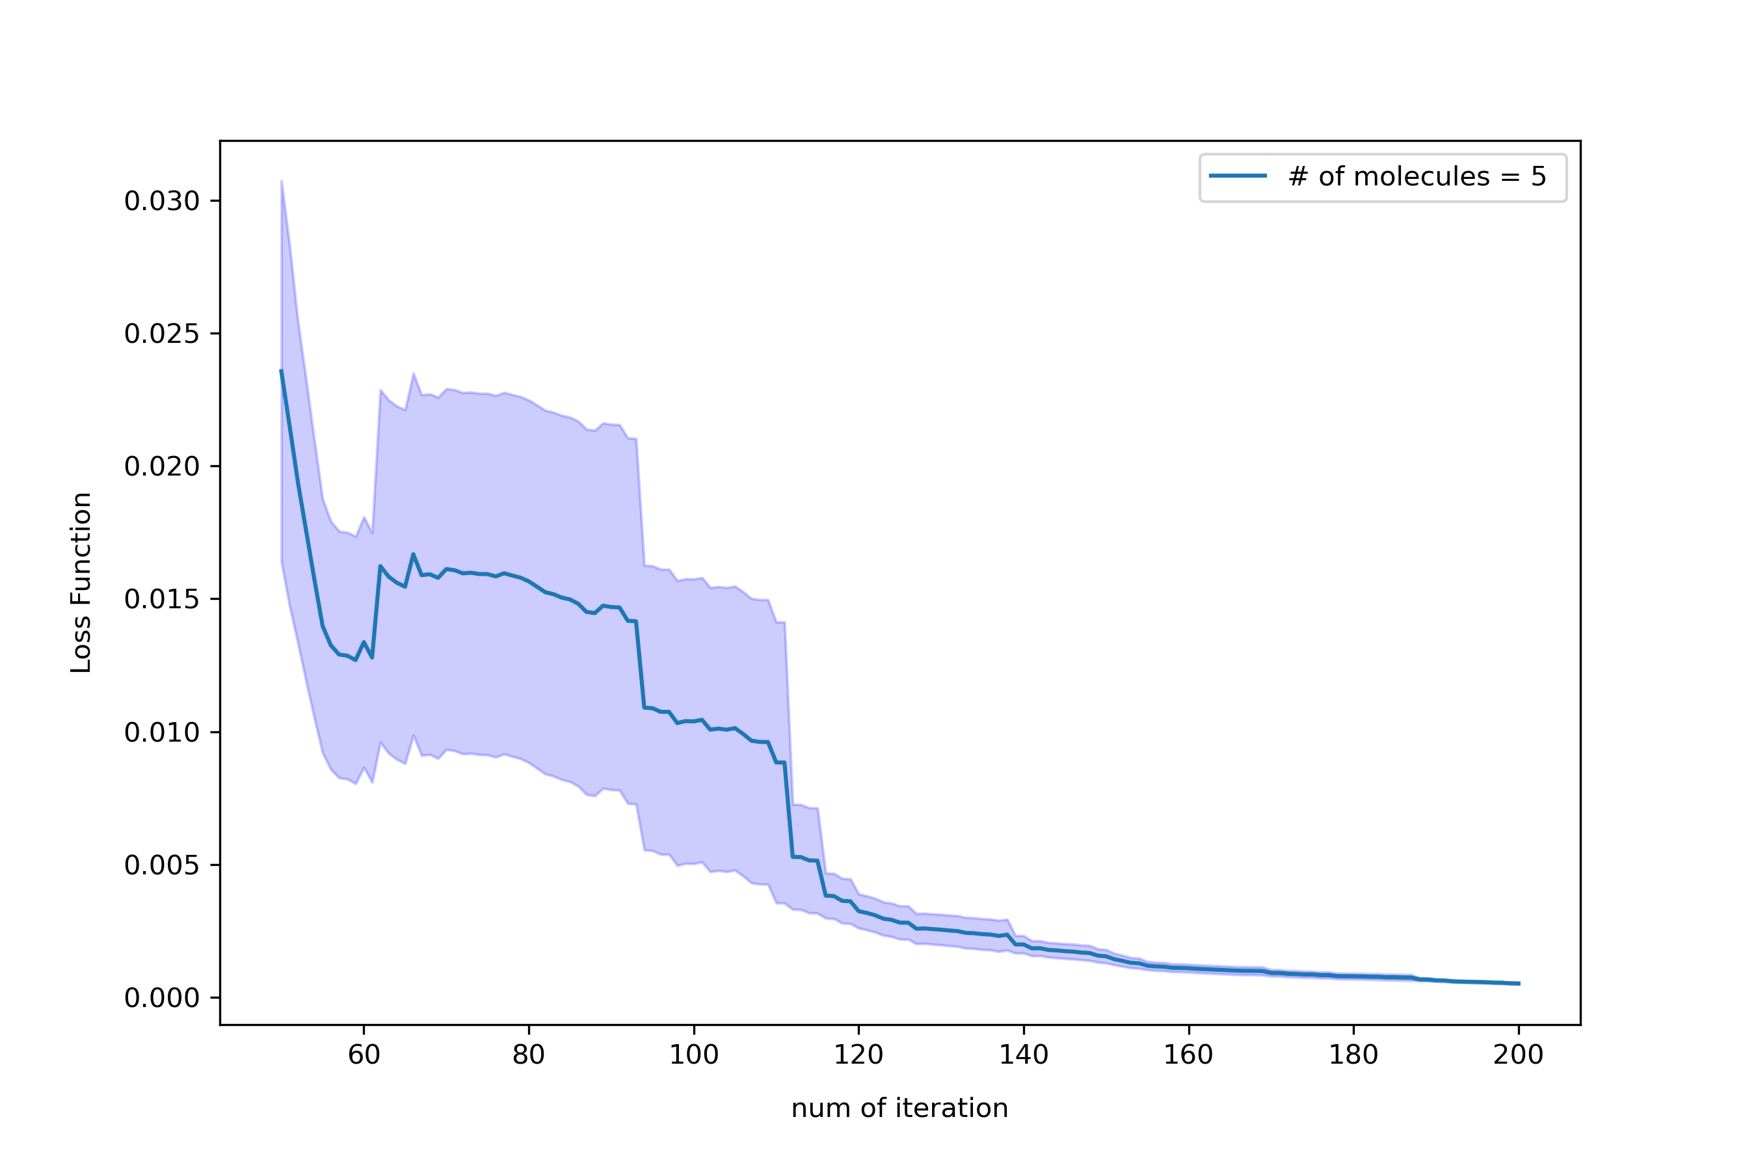
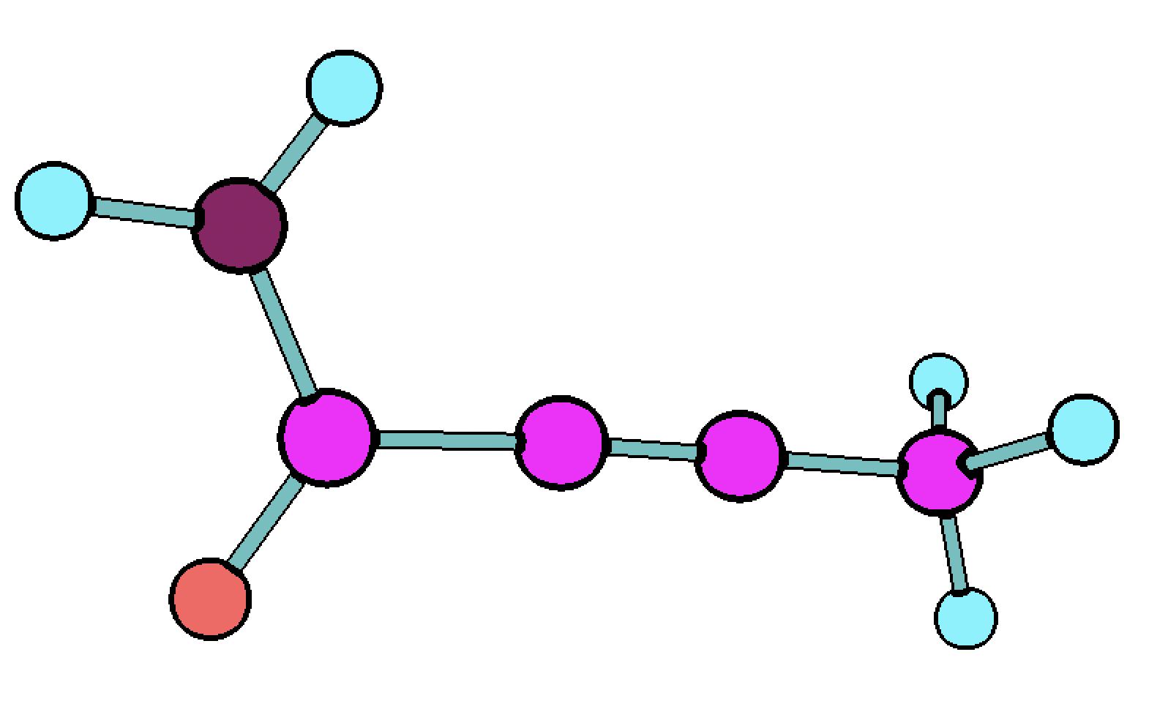
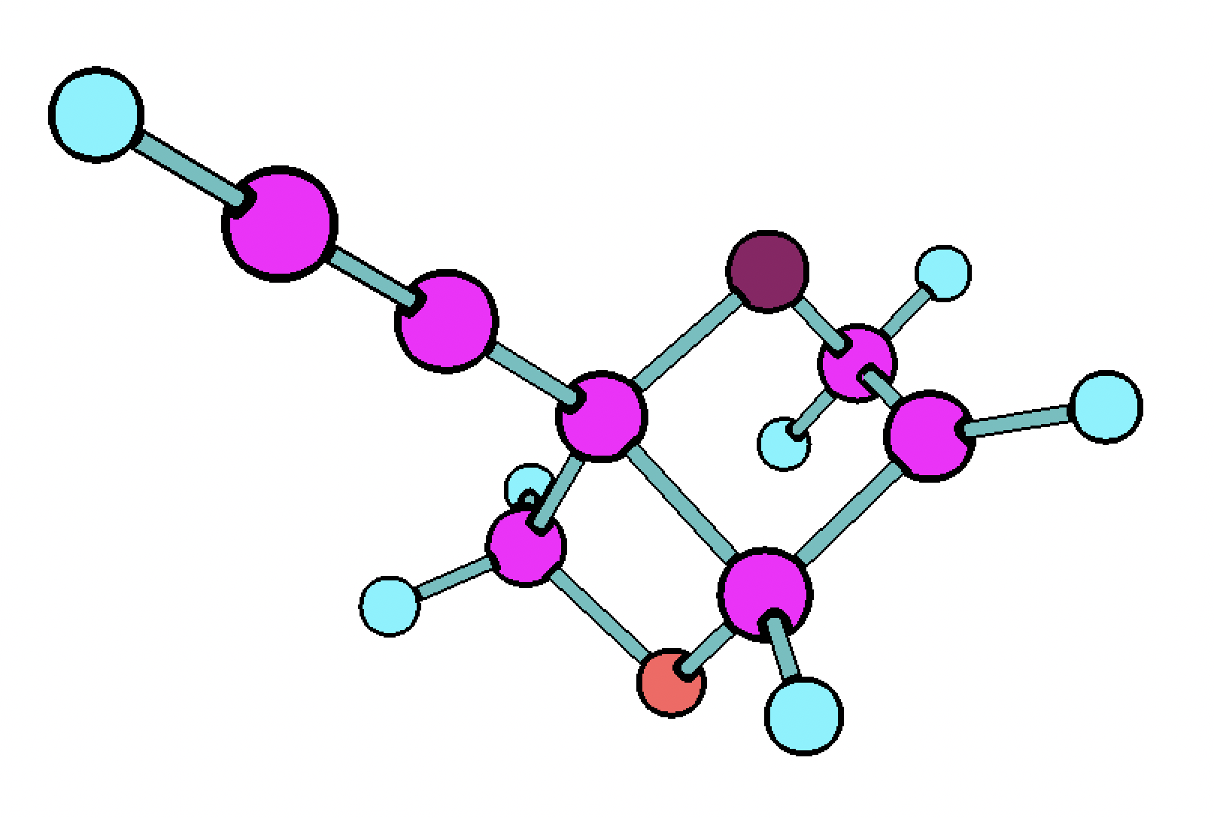
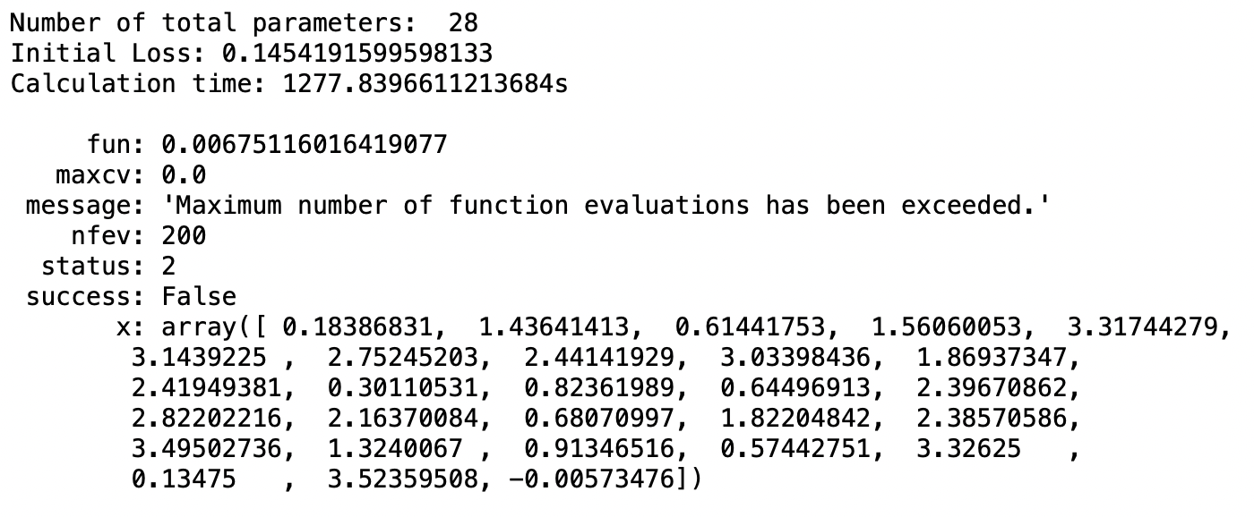
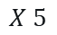
Results & Discussion
$$X 5$$
With M = 4 qubits

Slide 14

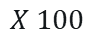
Results & Discussion
$$X 100$$
…. ????
With M = 8 qubits
Learning for 7 hours…
Tried to make it faster by changing codes, also tried hybrid model using torch.

Slide 15

Conclusions
We have suggested QML based molecule energy predictor
We got the circuit that can fit the 1 molecule’s energy
If everything goes well, we can use it for predicting many chemical, physical properties of molecules!
And… we made a good memory and friendship ^^

Slide 16
Thanks to…
Our mentors… Gyeonghun Kim, Utkarsh Azad
Every people who made this event possible ☺

